Slide 1
Online Retail Application Database
Submitted By:-
Revanth Kancharla-12005685
Siddharth Mehrotra- 12006050
E Naveen - 12006204

Slide 2
Introduction
This Java project provides a simple and user-friendly interface for both admins and users. The admin can log in to the system and perform crude operations on the products database, which is implemented using file handling in Java. The admin can add new products, delete existing products, update product details, and view all products in the database.
The user can also log in and place an order, after which they will receive a receipt for their purchase. The system also allows users to view their past orders and the list of available products in the database. The project provides efficient and secure handling of user and admin data, ensuring that only authorized personnel can access the system's features. Overall, this project is an effective solution for managing product orders and maintaining a product database in a convenient and secure manner.

Slide 3
In this project we have created four types of classes
We have also added the GUI interface in the project using the Java swing methods, so as soon as we run the source code in the compiler such as NetBeans or JDK a login window opens up which asks the user to choose between the user login or the admin login. After logging in the admin or the user dashboard appears where the user or the admin will be able to perform the functions we have made applicable to them respectively.
AdminDashboard
Login
Product
UserDashbord

Slide 4
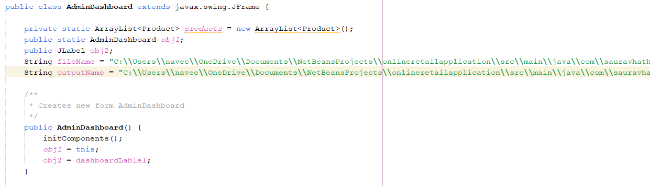
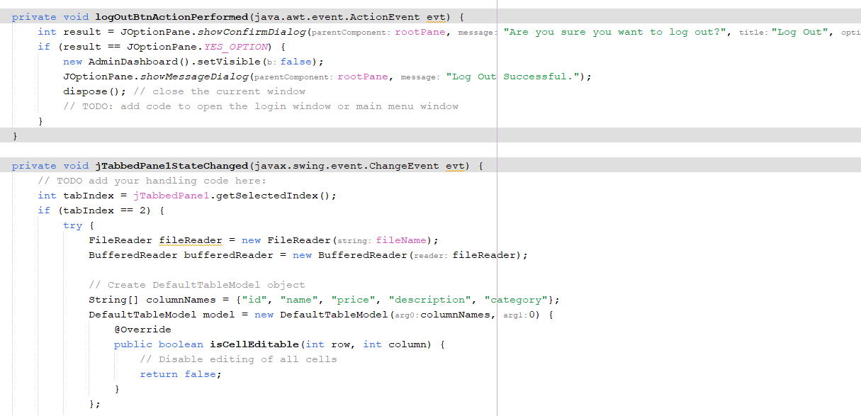
AdminDashboard

Slide 5
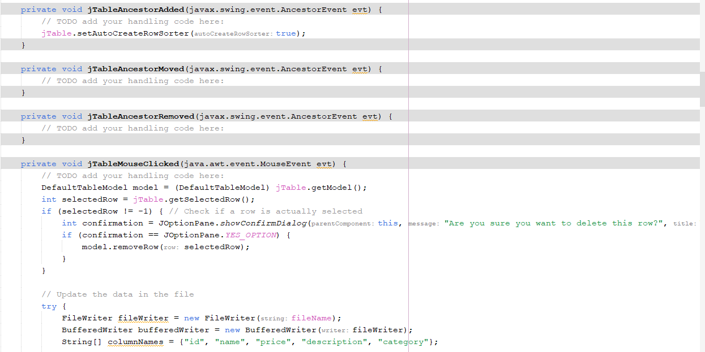
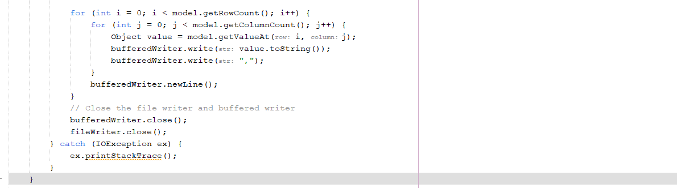

Slide 6
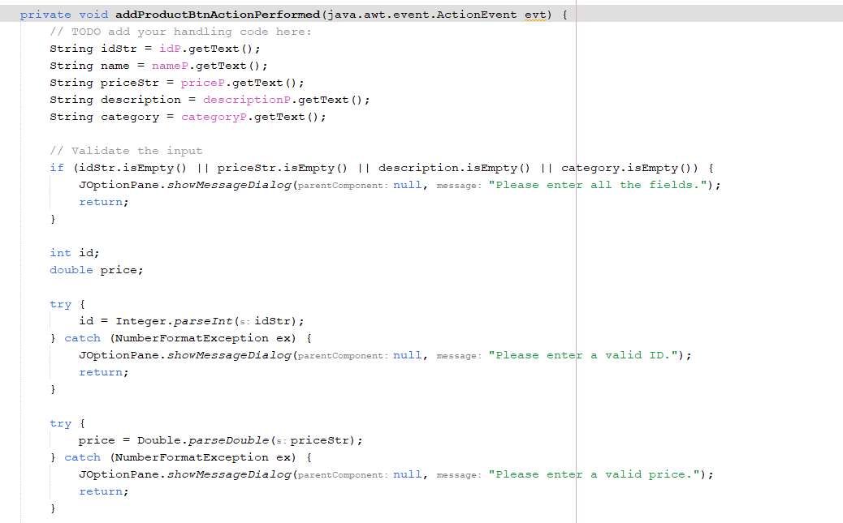
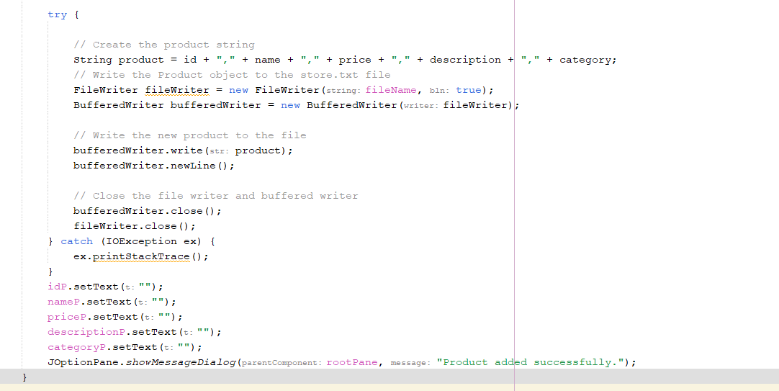

Slide 7
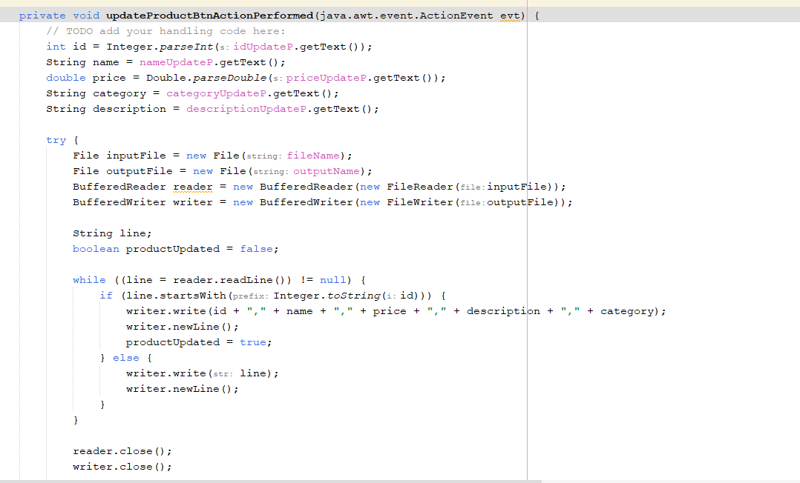
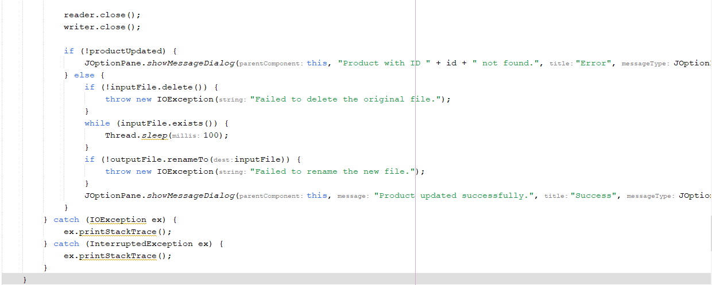

Slide 8
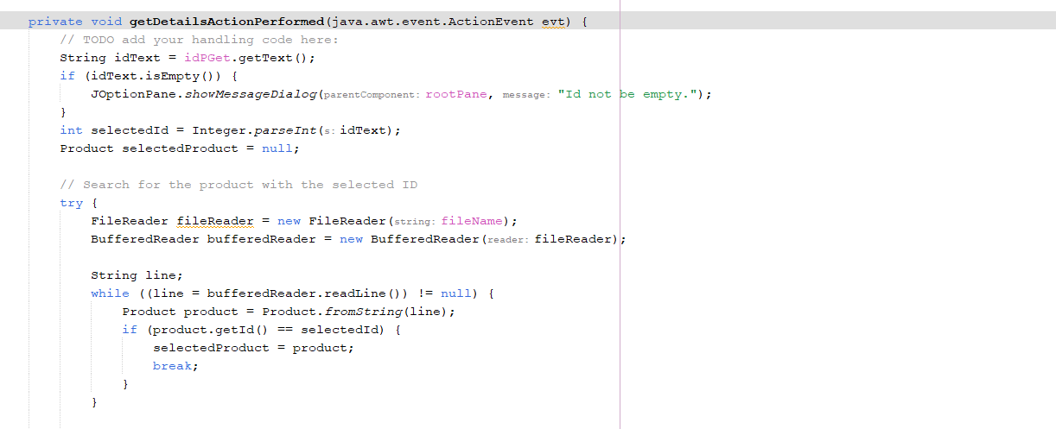
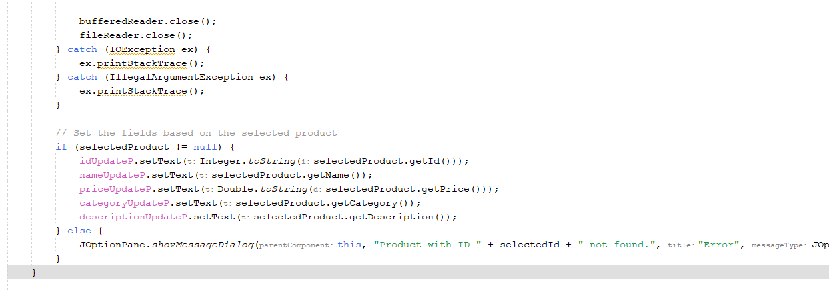

Slide 9
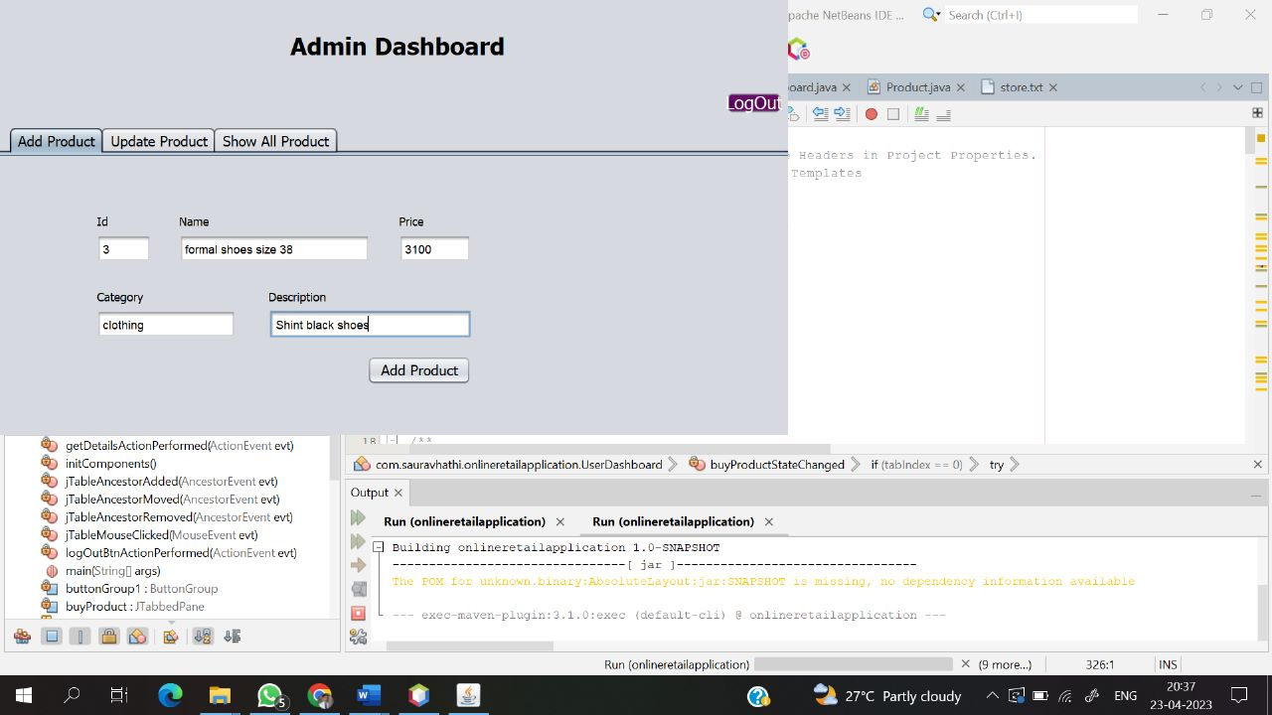
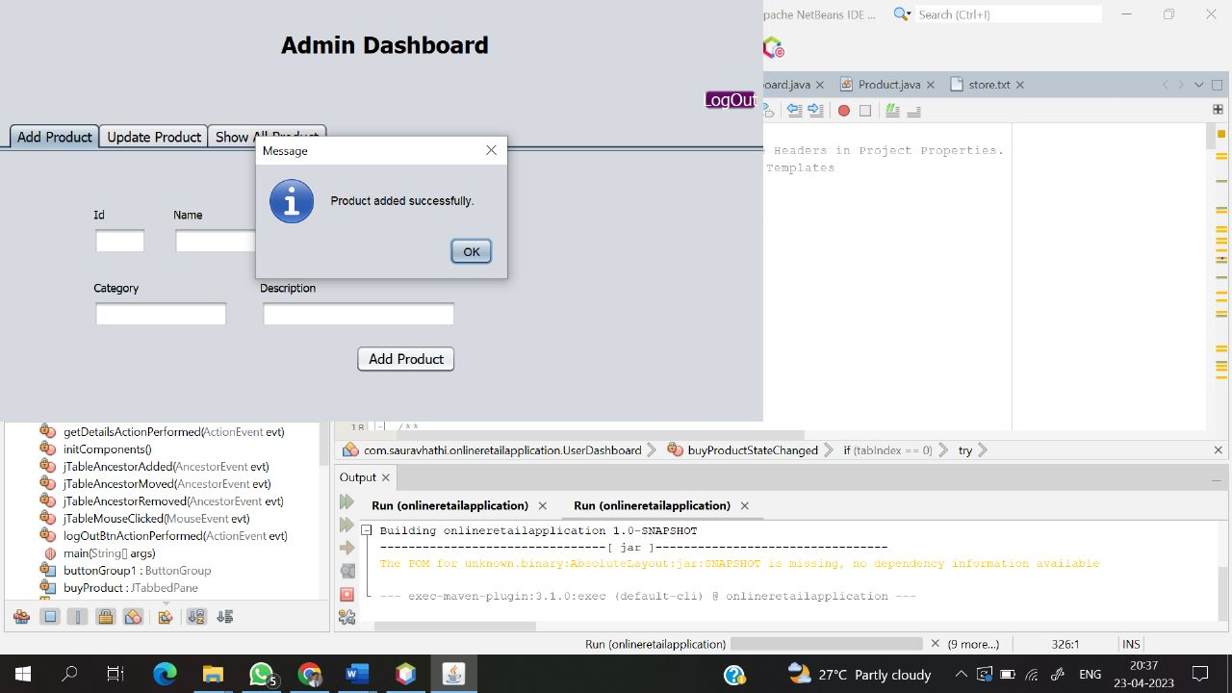
Output

Slide 10
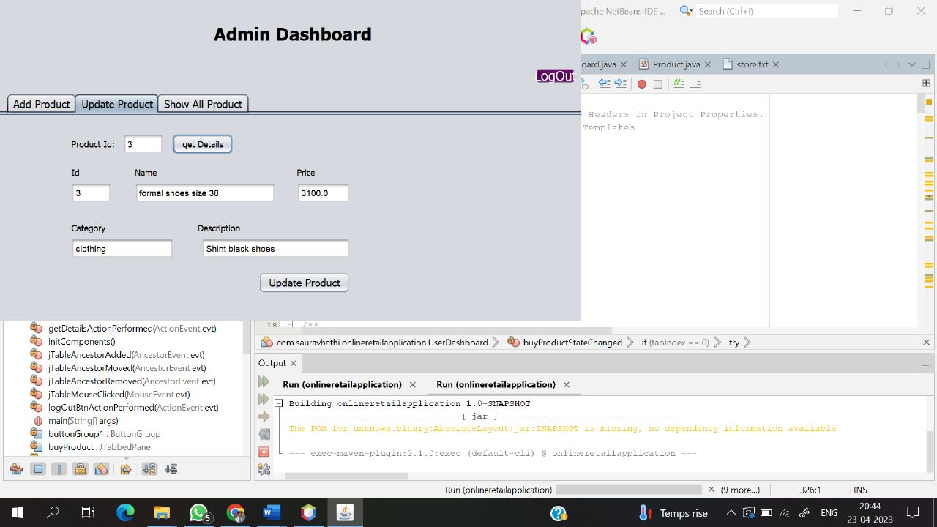
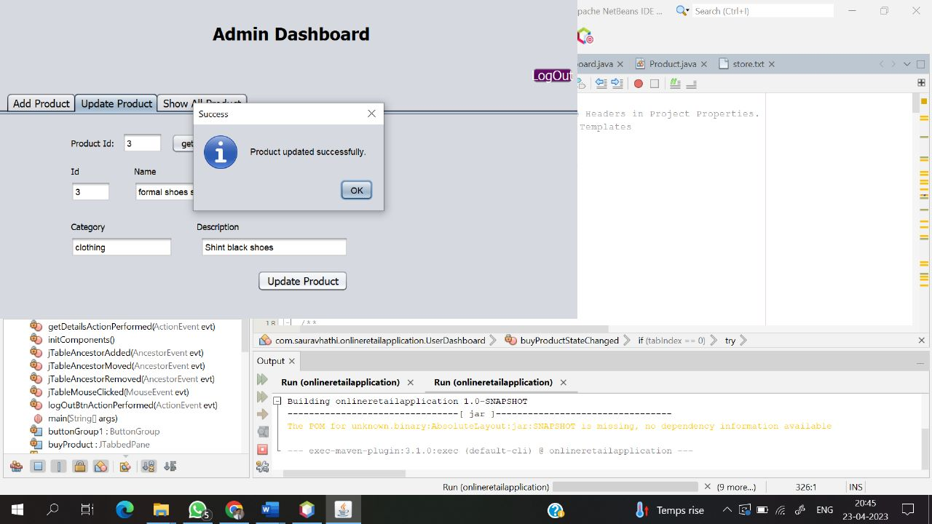

Slide 11
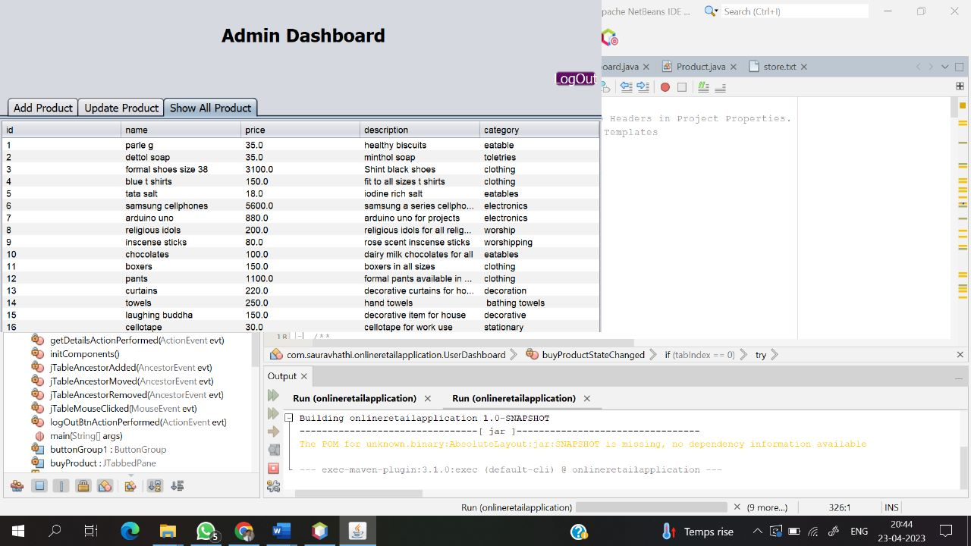

Slide 12
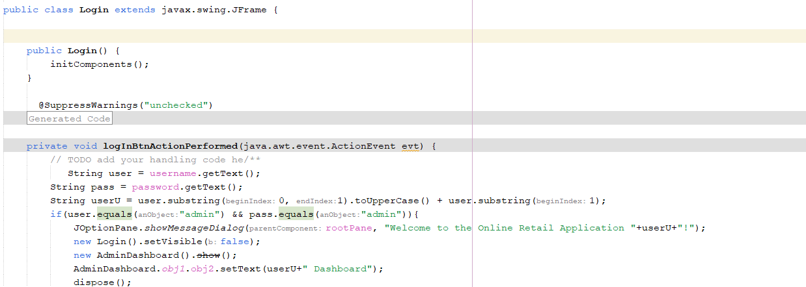
Login

Slide 13
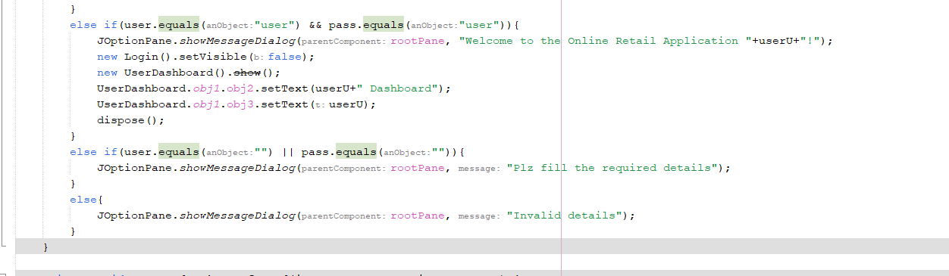
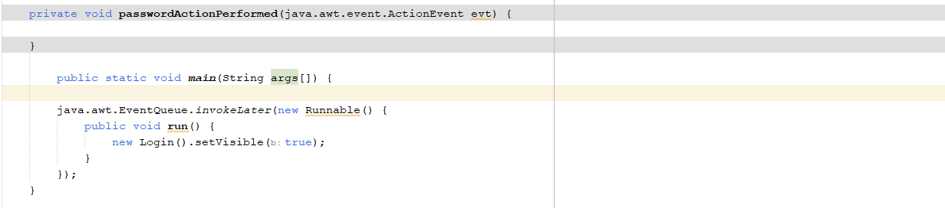

Slide 14
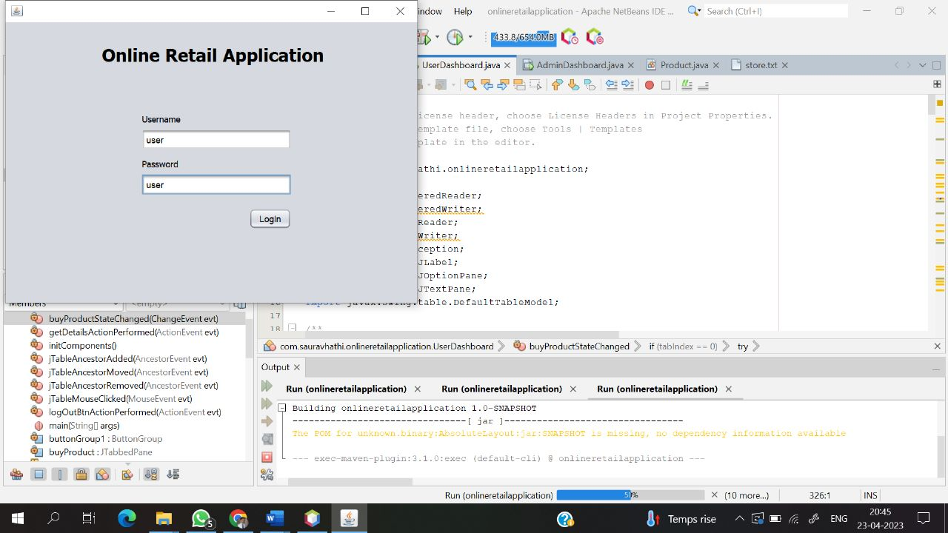
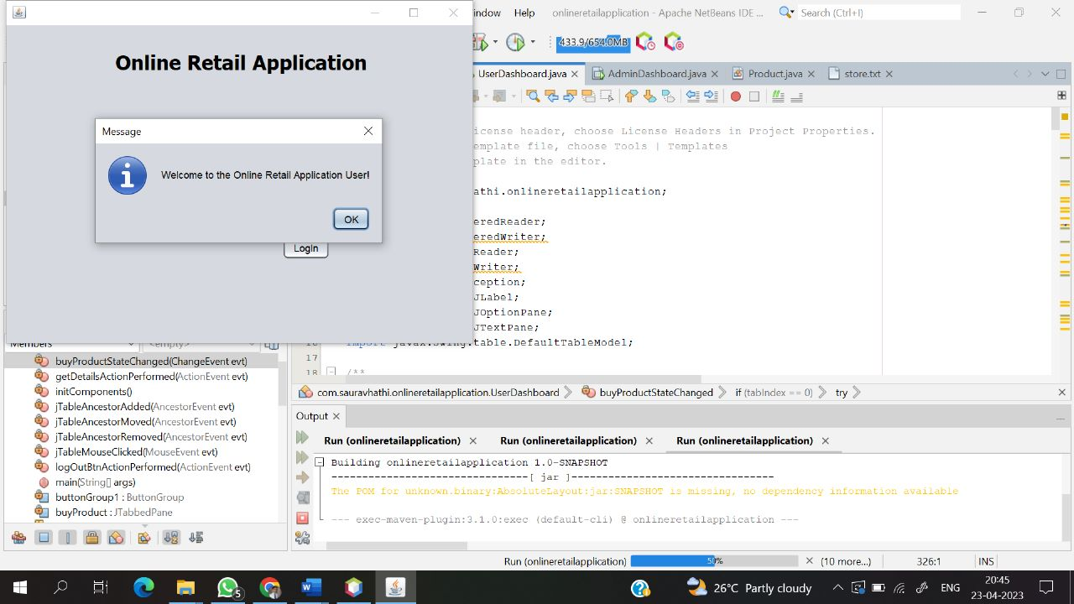
Output

Slide 15
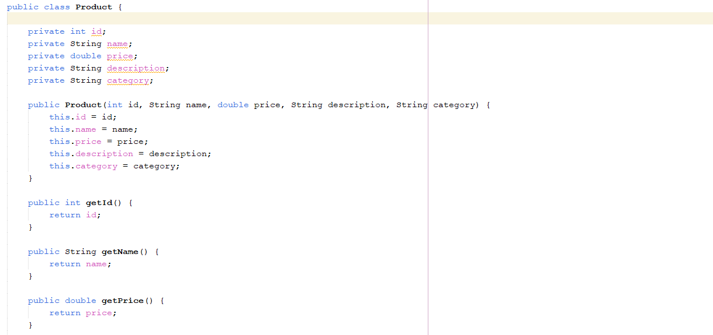
Product

Slide 16
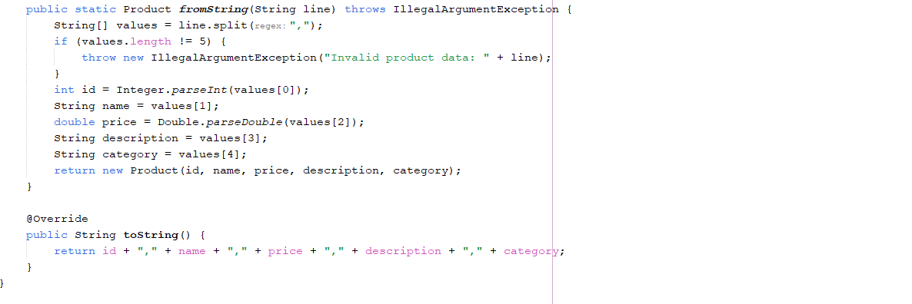

Slide 17
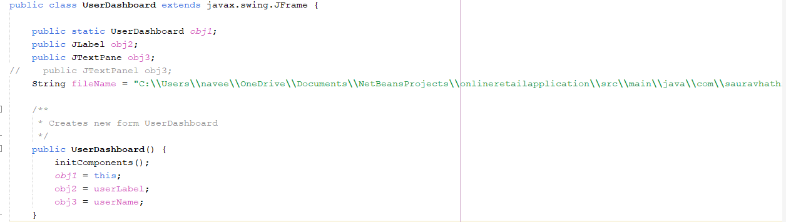
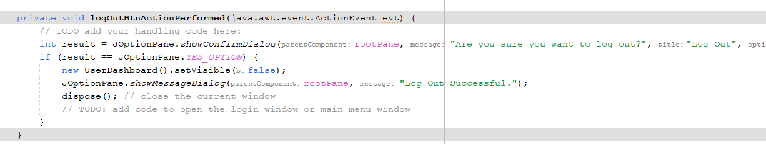
UserDashbord

Slide 18
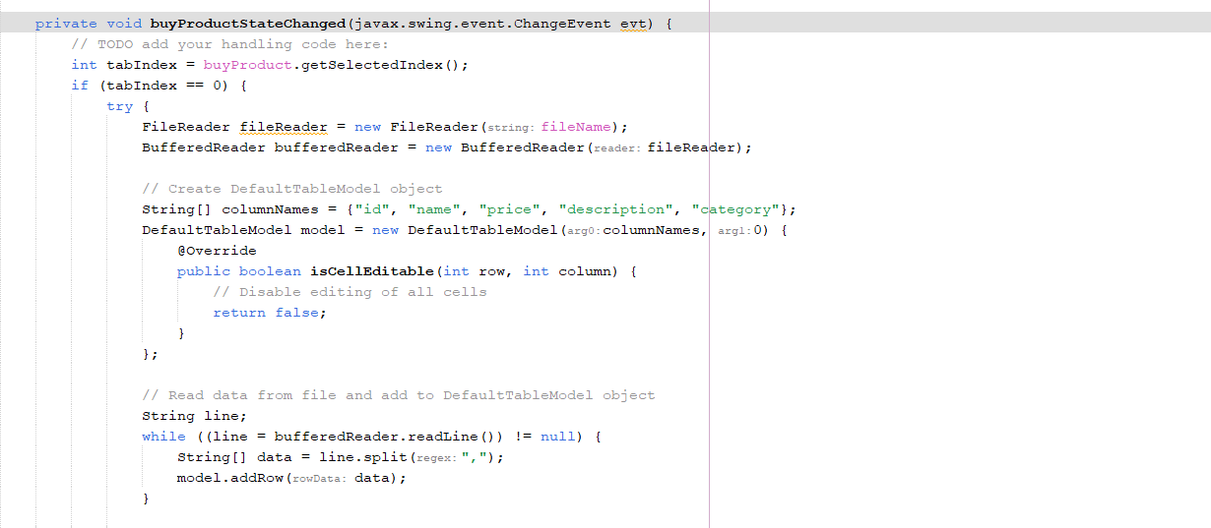

Slide 19
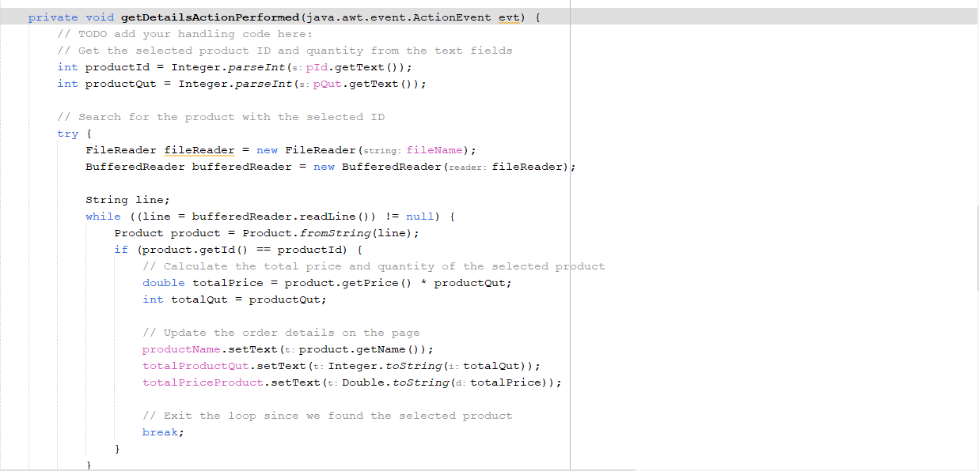

Slide 20
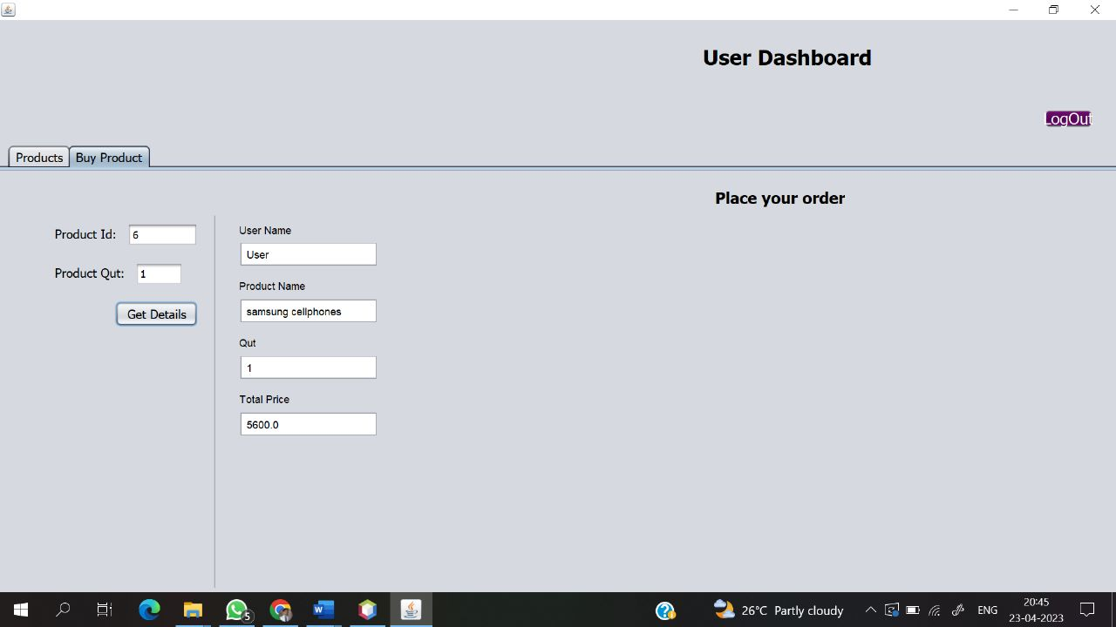
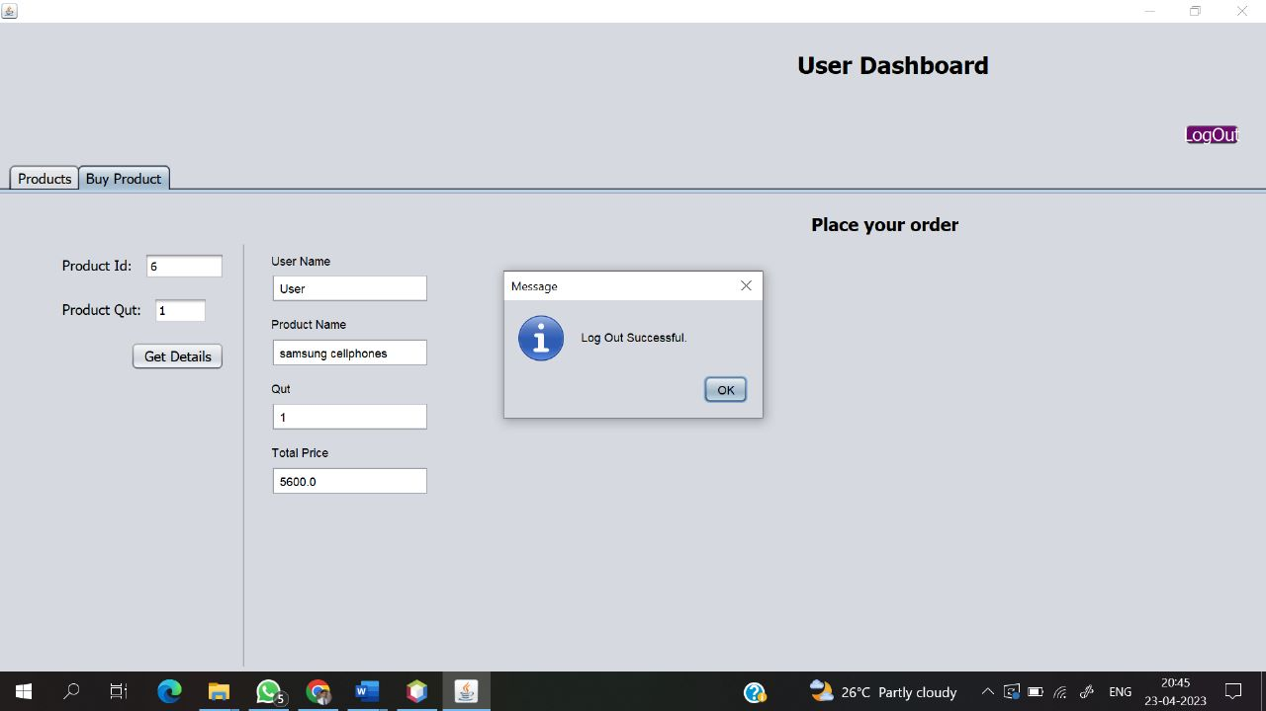
Output

Slide 21
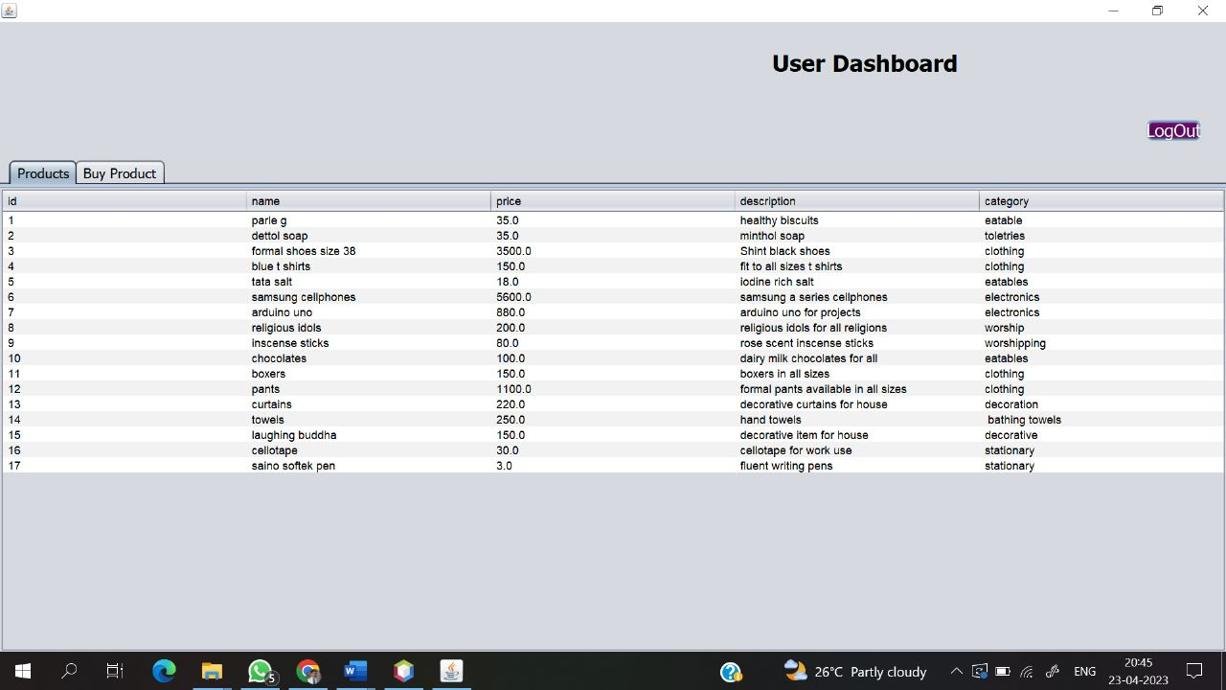

Slide 22
Thank You

